Slide 1
Auto Loan Securitization Analytics Dashboard
Power BI Internship Project
Developed by Sai Krishna

Slide 2

Project Overview
Objective: To analyze auto loan portfolio performance, credit risk, collections, losses, and vintage pool behavior using Power BI.
Tools Used:
Power BI
Excel
DAX
Key Areas:
Portfolio Overview
Risk Analysis
Collection Monitoring
Loss Analysis
Vintage Analysis

Slide 3

Dataset Overview
Content:
Dataset: | Purpose:
Auto Loan Securitisation Data | Portfolio Overview
DPD Snapshot History Dynamic Loss Monthly Static Pool Vintage Data | Delinquency Monitoring Loss Analysis Vintage Performance

Slide 4
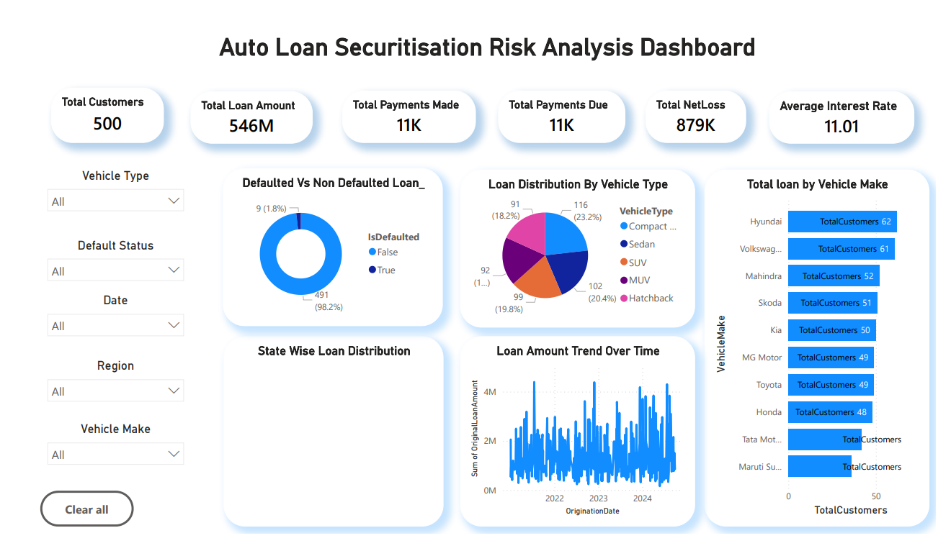
Auto Loan Portfolio Overview
Key Metrics:
Total Loan Amount
Average Interest Rate
Total Customers
Average CIBIL Score
Vehicle Distribution
Insights:
Loan portfolio spread across multiple vehicle types.
Significant exposure in specific vehicle segments.
Portfolio composition helps identify growth opportunities.

Slide 5
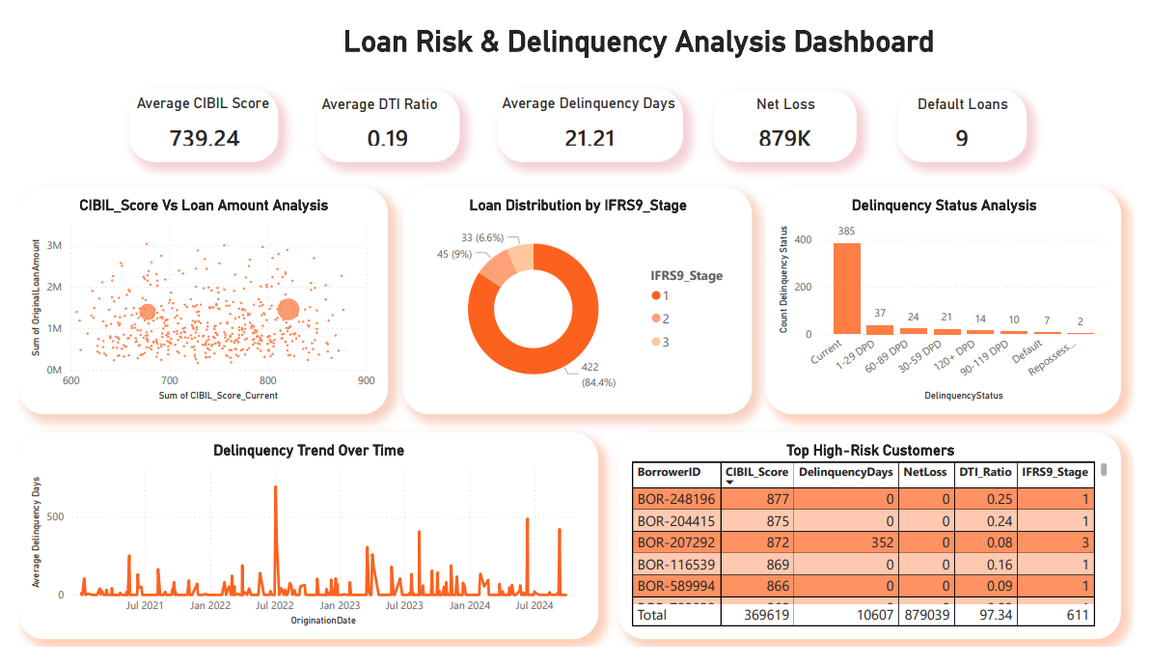
Loan Risk & Delinquency Analysis
Key Metrics:
Average CIBIL Score
Average DTI Ratio
Delinquency Days
Net Loss
IFRS9 Stage Distribution
Insights:
Higher delinquency observed in specific customer segments.
IFRS9 classification helps identify risky accounts.
Net loss trends indicate portfolio risk concentration.

Slide 6
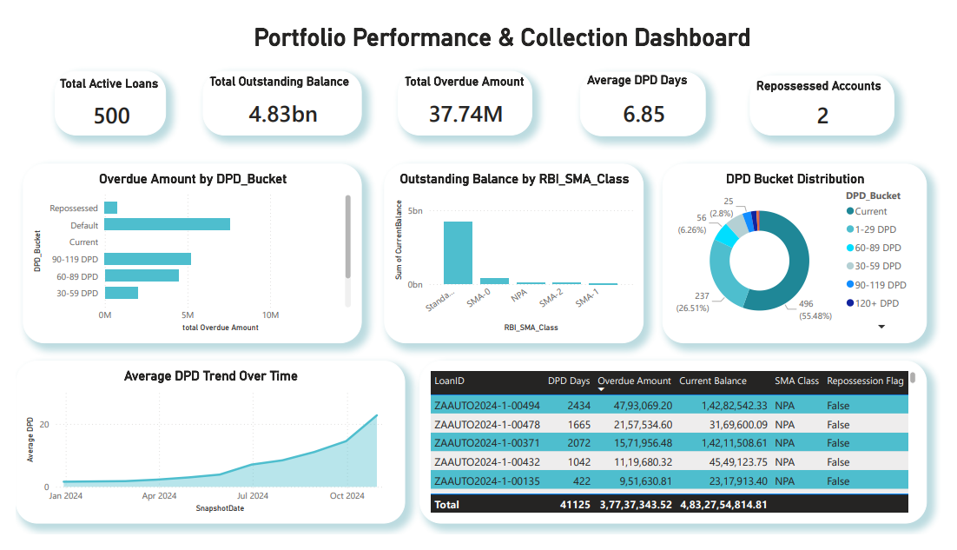
Portfolio Performance & Collection Dashboard
Key Metrics:
Outstanding Balance
Overdue Amount
Average DPD Days
Active Loans
Repossessed Accounts
Insights:
DPD bucket analysis highlights overdue loan distribution.
Collection trends indicate recovery effectiveness.
SMA classifications help monitor stressed accounts.

Slide 7
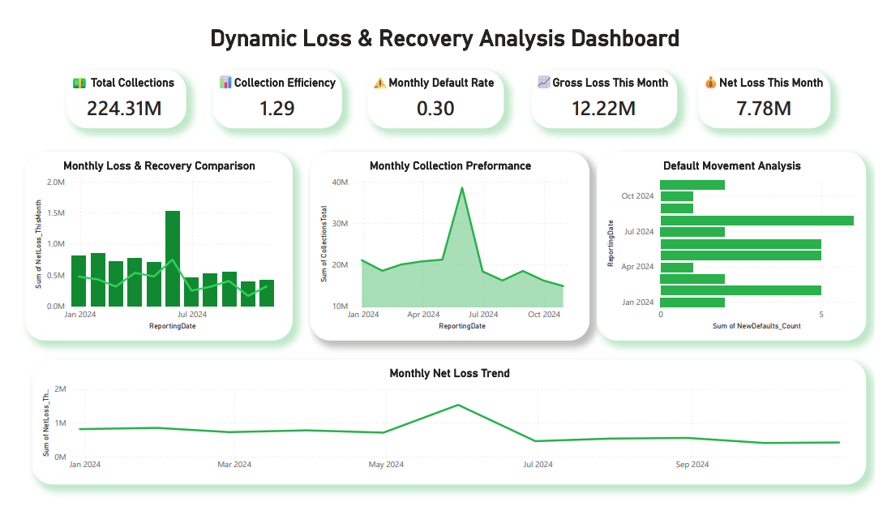
Dynamic Loss & Recovery Analysis
Key Metrics:
Net Loss
Recovery Amount
Collection Efficiency
Monthly Default Rate
Insights:
Recovery trends help reduce portfolio losses.
Monthly loss tracking supports proactive risk management.
Collection efficiency reflects operational performance.

Slide 8
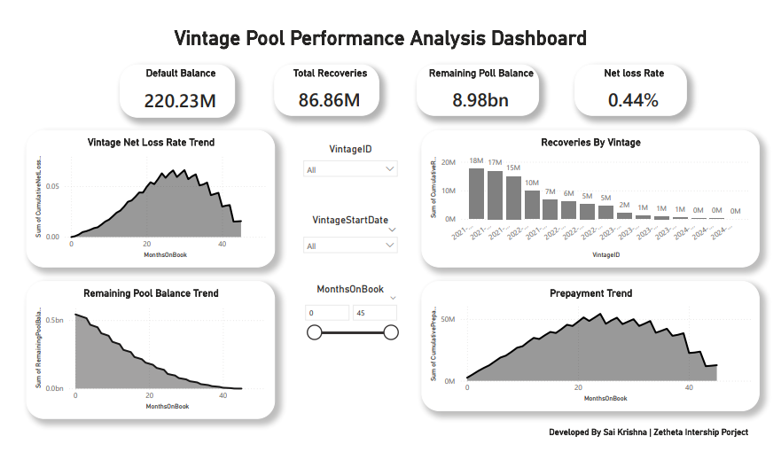
Vintage Pool Performance Analysis
Key Metrics:
Net Loss Rate
Default Balance
Total Recoveries
Remaining Pool Balance
Insights:
Vintage analysis tracks long-term loan performance.
Pool balances decline consistently over time.
Recoveries offset losses across vintages.

Slide 9

Key Business Insights
Major Findings:
Portfolio maintains strong loan balance performance.
Delinquency concentrated in limited customer groups.
Recovery activities significantly reduce losses.
Vintage pools demonstrate stable long-term performance.
Collection efficiency remains healthy across periods.
Business Impact:
Better risk monitoring
Improved collection strategy
Enhanced portfolio visibility

Slide 10

Conclusion & Future Scope
Conclusion:
Developed a comprehensive Auto Loan Securitization Analytics Dashboard using Power BI.
Analyzed portfolio performance, credit risk, delinquency trends, collections, losses, and vintage pool behavior.
Identified key risk indicators such as DPD, IFRS9 stages, net loss rates, and recovery performance.
Enabled data-driven decision making through interactive dashboards and KPI monitoring.
Future Scope:
Integrate real-time loan portfolio data.
Implement predictive default risk models using Machine Learning.
Enhance dashboards with drill-through reports and advanced analytics.
Automate portfolio monitoring and risk alerts.

Slide 11
THANK YOU
Developed by Sai Krishna | ZeTheta Internship Project

